Slide 1
Monday

Slide 2
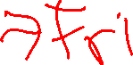
Course Logistics
Problem Set 5 – Due Friday, April 14
Project Milestone 3 – Due Wednesday!
Friday OH moved to 9:30AM
Or by appointment

Slide 3
Clustering
Clustering – ground truth X
- No ground truth Y*
- Trying to develop classes from the bottom up
- Trying to build based on hidden structure
Finding clusters such that
- Examples within a cluster are similar
- Examples between clusters are dissimilar
*Ground truth may actually exist, we just a) can’t capture it, or b) are choosing to not use it for our task

Slide 4
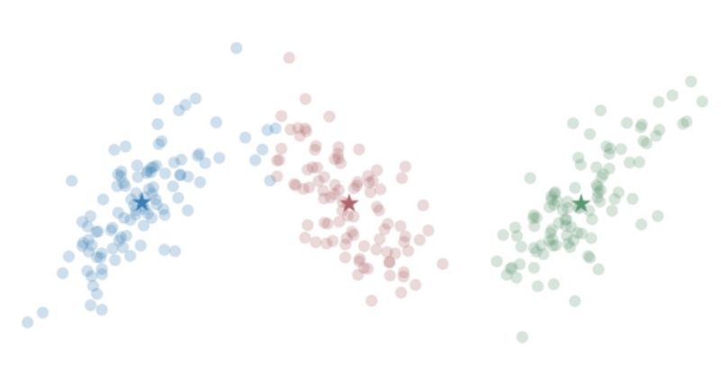
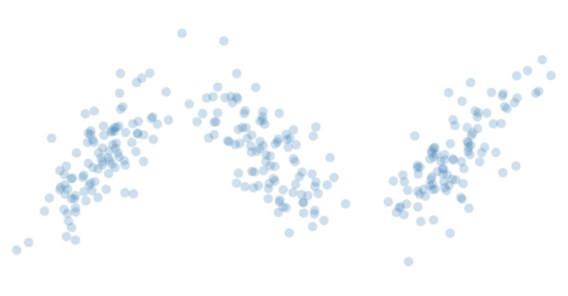
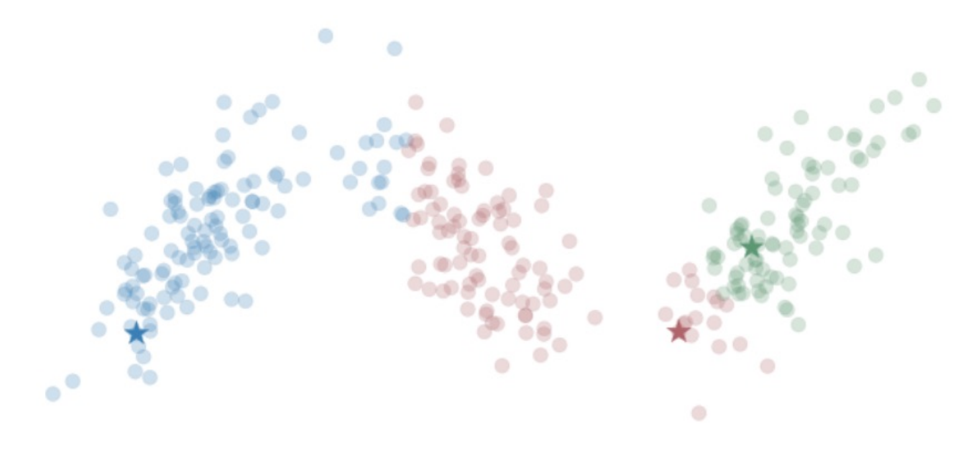
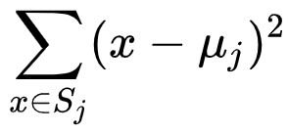
Clustering – K Means
Start with your Data
Choose K centroids
Until we converge:
Reassign points
Re-center
What do we minimize?
Sample to Centroid Distance

Slide 5


K Means - # Clusters
Expectation with 3 clusters

Slide 6
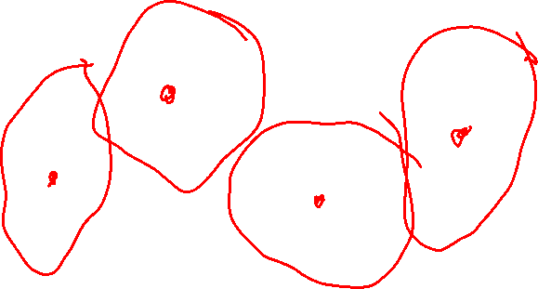
K Means - # Clusters
Expectation with 4 clusters?

Slide 7

K Means - # Clusters
Expectation with 1 clusters?

Slide 8
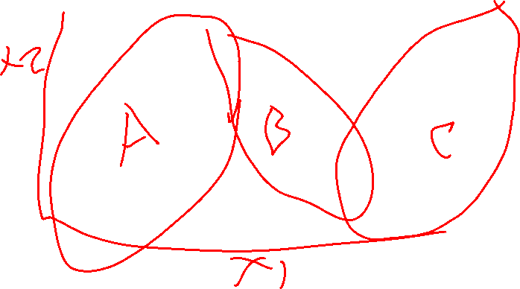
K Means - # Clusters
Choose a theoretically grounded value
- based on the “secret” ground-truth classification
- based on a hypothesis from other research
- based on prior work

Slide 9
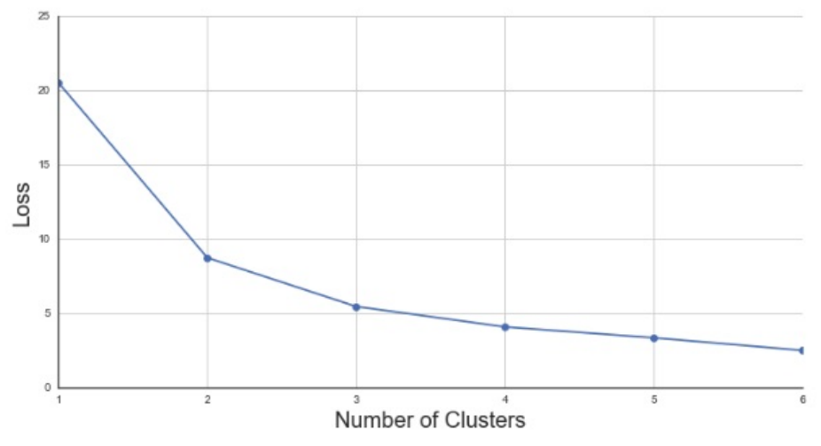

K Means - # Clusters
Elbow Method
- Choose the number of clusters with the most change in the derivative of the loss (i.e. choose the most bent elbow)
L2 Cost Function
Notes:
https://en.wikipedia.org/wiki/K-means_clustering

Slide 10
K Means – Other Cluster Metrics
Gap Statistic
Silhouette
https://towardsdatascience.com/10-tips-for-choosing-the-optimal-number-of-clusters-277e93d72d92

Slide 11

K Means – Scale of Dimensions
Clusters of SAT and ACT scores (fake example)
36
ACT
Score
0
1600
SAT Score

Slide 12
K Means – Categorical Data
Will this approach work?

Slide 13
K Means – Categorical Data
Solution: Encode same or different / create one-hot vectors

Slide 14
K Means – Categorical Data
Solution: Encode same or different / create one-hot vectors
Improvement: adjust distance based on how common an option is
- If 90% of your sample is non-smoking, being a smoking sample is more of an oddity, so perhaps it should differentiate a cluster

Slide 15
K Means – Categorical Data
Solution: Encode same or different / create one-hot vectors
Improvement: adjust distance based on how common an option is
- If 90% of your sample is non-smoking, being a smoking sample is more of an oddity, so perhaps it should differentiate a cluster
- K Means – adjust based on popularity for non-binary
- K Modes – simplify as binary, either most popular choice or not
https://shapeofdata.wordpress.com/2014/03/04/k-modes/

Slide 16
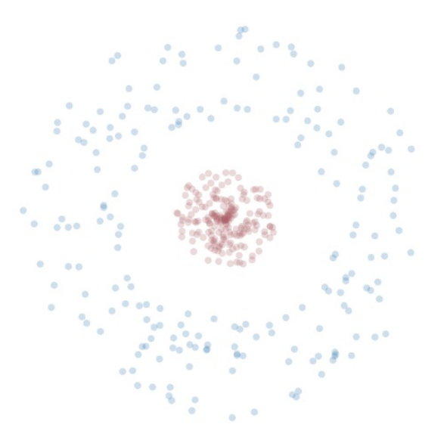

K Means – Non-Convex Clusters

Slide 17
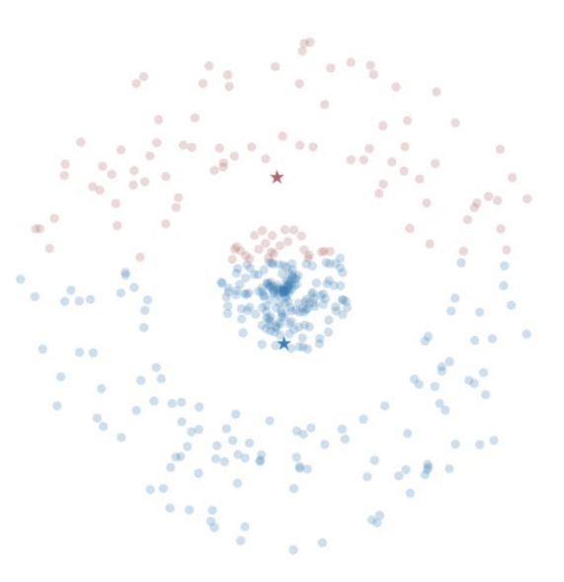
K Means – Non-Convex Clusters

Slide 18
K Means – Convex Clusters Solutions
Transform your data?

Slide 19
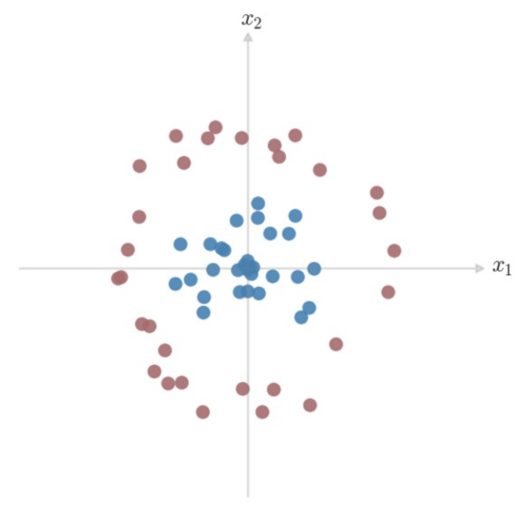
Dimension Projection
How would we separate these classes?
What kind of boundary can we give
this space?
Can we express that boundary in
terms of our given features?

Slide 20
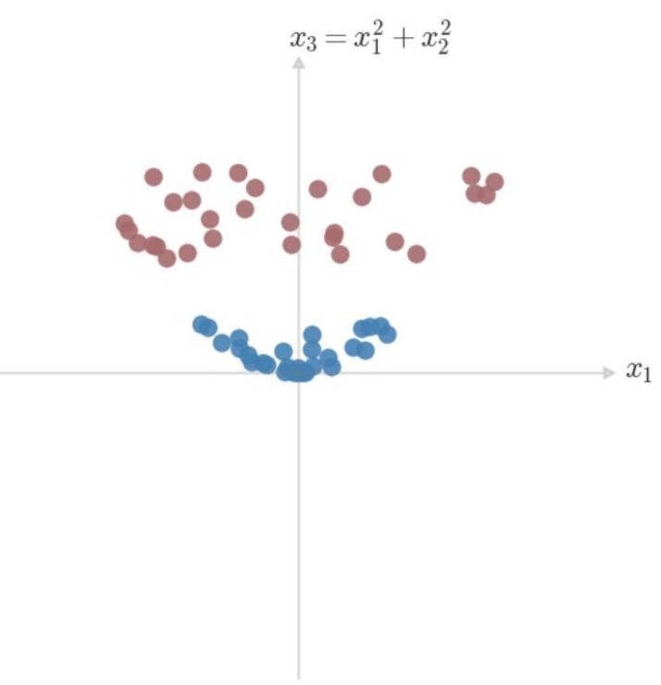

Dimension Projection
How would we separate these classes?
What kind of boundary can we give
this space?
Can we express that boundary in
terms of our given features?

Slide 21
K Means – Convex Clusters Solutions
Transform your data, add iterative testing?

Slide 22
K Means – Pros & Cons
PROS
Simple to understand & implement
Very fast to converge
Can make theoretical sense when mapping to cluster features

Slide 23
K Means – Pros & Cons
PROS
Simple to understand & implement
Very fast to converge
Can make theoretical sense when mapping to cluster features
CONS
Doesn’t handle non-convex clusters well
Sensitive to oddities from outliers, initialization
Makes a hard choice (assigns to one and only one cluster)

Slide 24
Generalizing K Means
Is there a way we can discuss clusters without a hard decision boundary?

Slide 25
Generalizing K Means
Is there a way we can discuss clusters without a hard decision boundary?
Add a probability to the assignment!

Slide 26
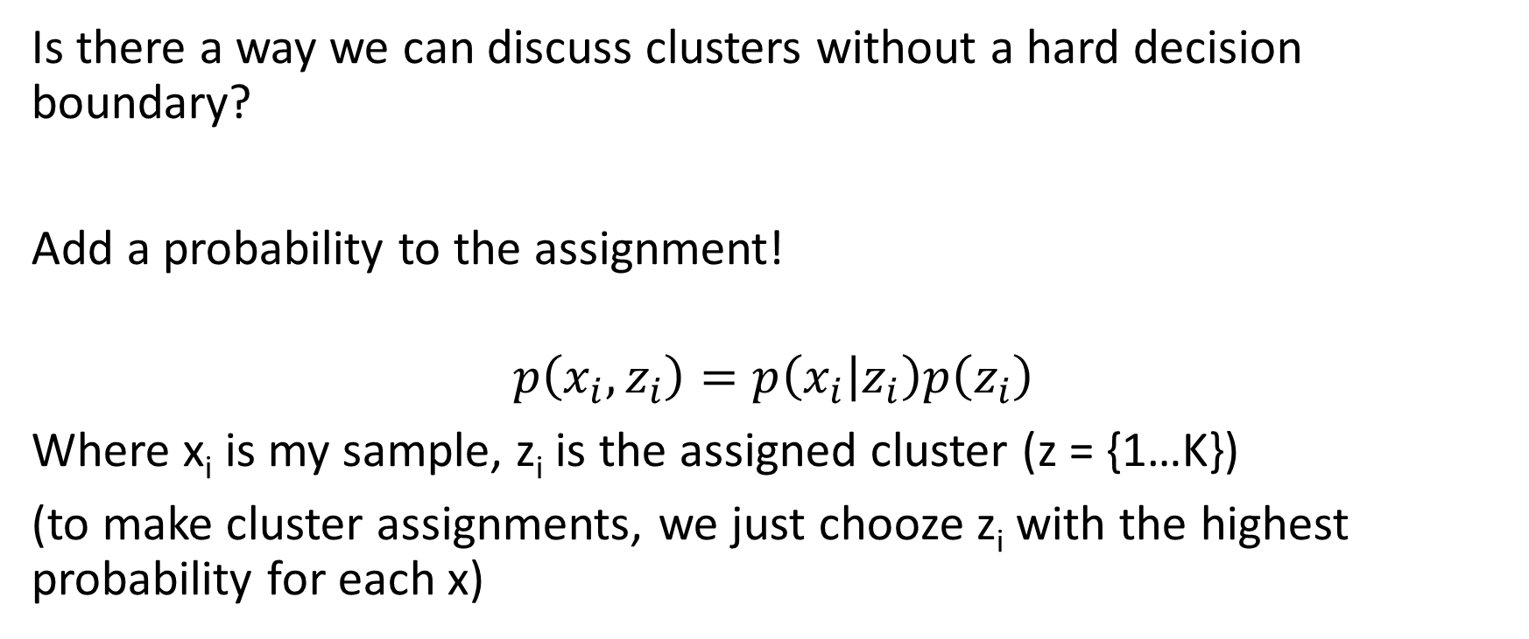
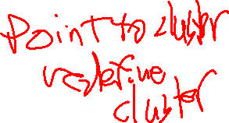
Generalizing K Means
Is there a way we can discuss clusters without a hard decision boundary?
Add a probability to the assignment!
$$p\left(x_{i},z_{i}\right)=p\left(x_{i} | z_{i}\right)p\left(z_{i}\right)$$
Where x_{i} is my sample, z_{i} is the assigned cluster (z = {1…K})
(to make cluster assignments, we just chooze z_{i} with the highest probability for each x)

Slide 27
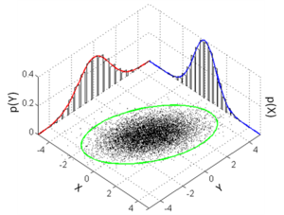
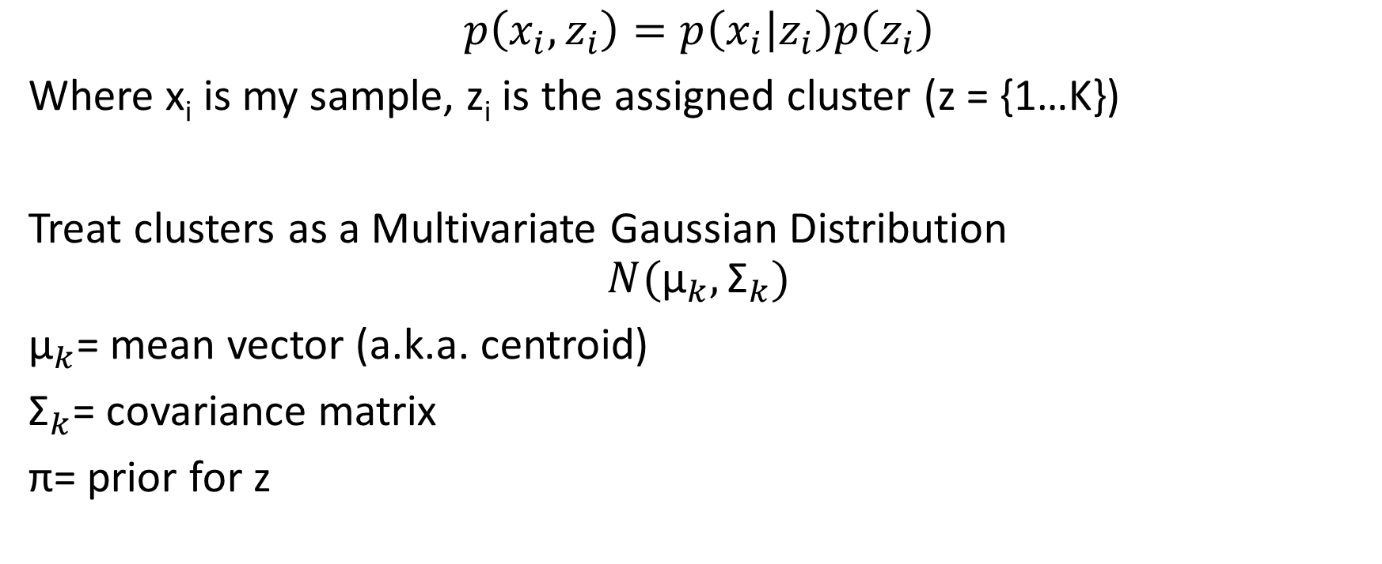

Generalizing K Means – Gaussian Distribution
$$p\left(x_{i},z_{i}\right)=p\left(x_{i} | z_{i}\right)p\left(z_{i}\right)$$
Where x_{i} is my sample, z_{i} is the assigned cluster (z = {1…K})
Treat clusters as a Multivariate Gaussian Distribution
$$N({\text{μ}}_{k},{\text{Σ}}_{k})$$
${\text{μ}}_{k}$= mean vector (a.k.a. centroid)
${\text{Σ}}_{k}$= covariance matrix
$\text{π}$= prior for z
Notes:
https://en.wikipedia.org/wiki/Multivariate_normal_distribution

Slide 28
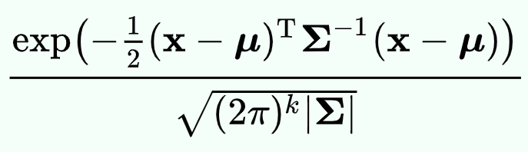
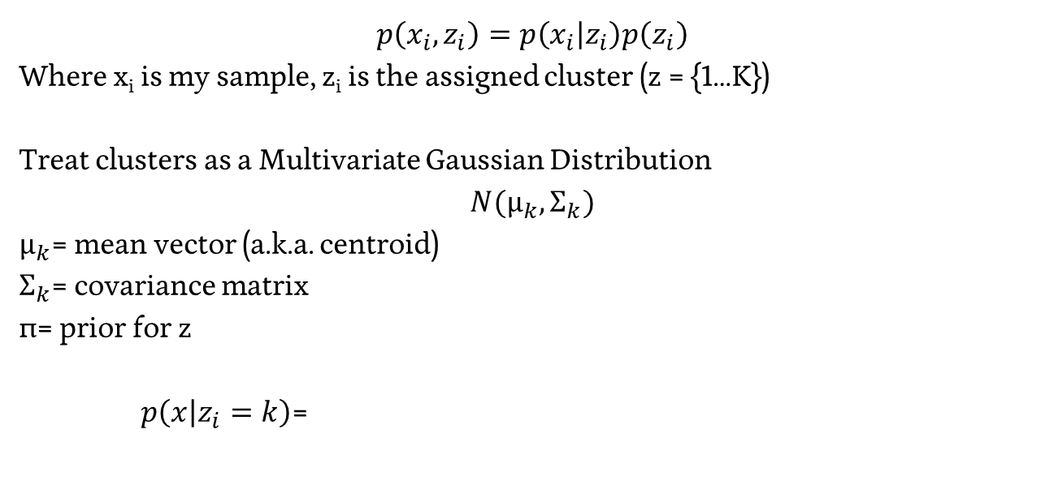
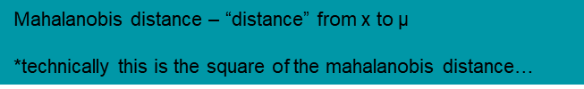
Generalizing K Means – Gaussian Distribution
$$p\left(x_{i},z_{i}\right)=p\left(x_{i} | z_{i}\right)p\left(z_{i}\right)$$
Where x_{i} is my sample, z_{i} is the assigned cluster (z = {1…K})
Treat clusters as a Multivariate Gaussian Distribution
$$N({\text{μ}}_{k},{\text{Σ}}_{k})$$
${\text{μ}}_{k}$= mean vector (a.k.a. centroid)
${\text{Σ}}_{k}$= covariance matrix
$\text{π}$= prior for z
$p\left(x | z_{i}=k\right)$=
Mahalanobis distance – “distance” from x to $\text{μ}$
*technically this is the square of the mahalanobis distance…
Notes:
https://en.wikipedia.org/wiki/Multivariate_normal_distribution

Slide 29
Gaussian Distribution – Gaussian Mixture Model
We can define the probability a set of points x is sampled from a multivariate gaussian…

Slide 30
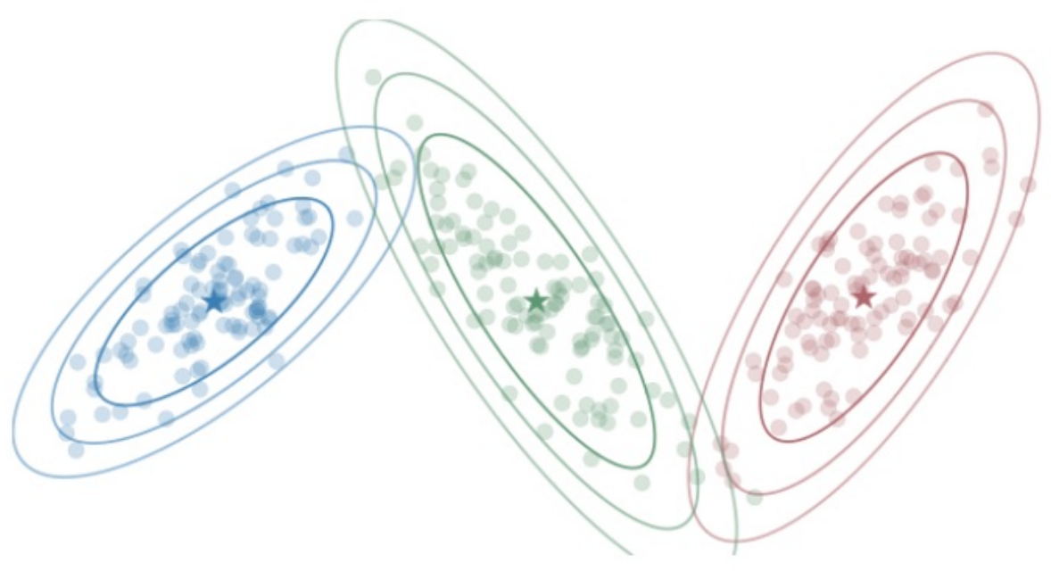
Gaussian Distribution – Gaussian Mixture Model
We can define the probability a set of points x is sampled from a multivariate gaussian…
Let’s try to find a set (mixture) of gaussians that best model the data!

Slide 31
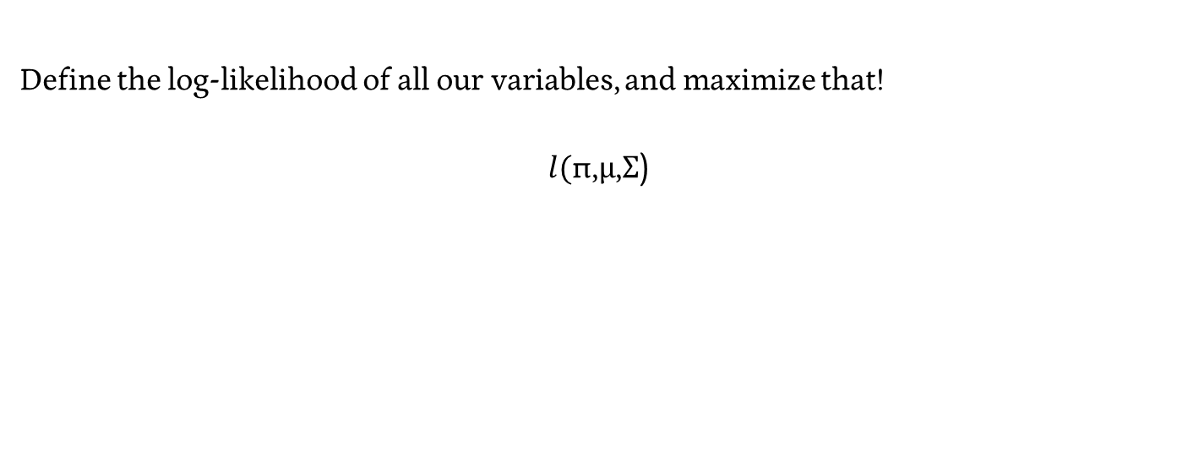
Gaussian Mixture Model – Maximum Likelihood
Define the log-likelihood of all our variables, and maximize that!
$$l(\text{π}\text{,}\text{μ}\text{,}\text{Σ}\text{)}$$

Slide 32
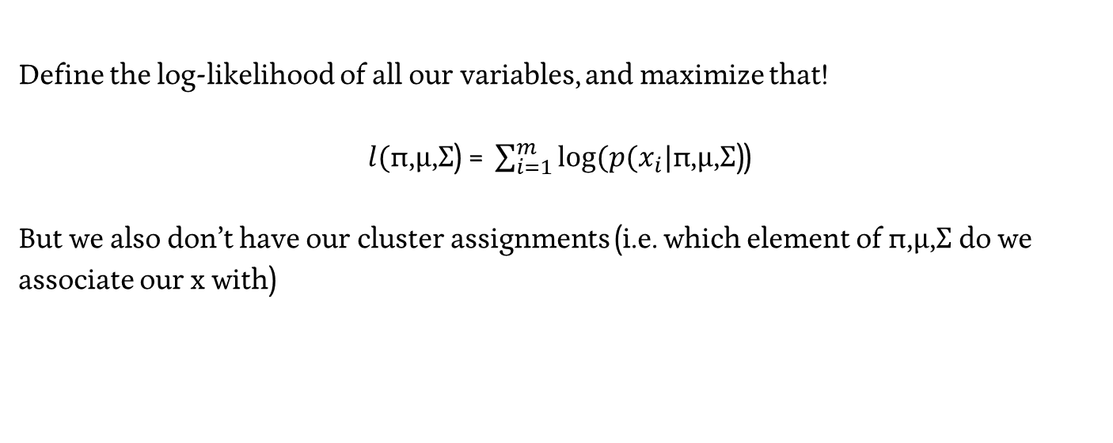
Gaussian Mixture Model – Maximum Likelihood
Define the log-likelihood of all our variables, and maximize that!
$l(\text{π}\text{,}\text{μ}\text{,}\text{Σ}\text{) = }\sum_{i=1}^{m}{log⁡(p(x_{i}|\text{π}\text{,}\text{μ}\text{,}\text{Σ}\text{)}}$)
But we also don’t have our cluster assignments (i.e. which element of $\text{π}\text{,}\text{μ}\text{,}\text{Σ}$ do we associate our x with)

Slide 33
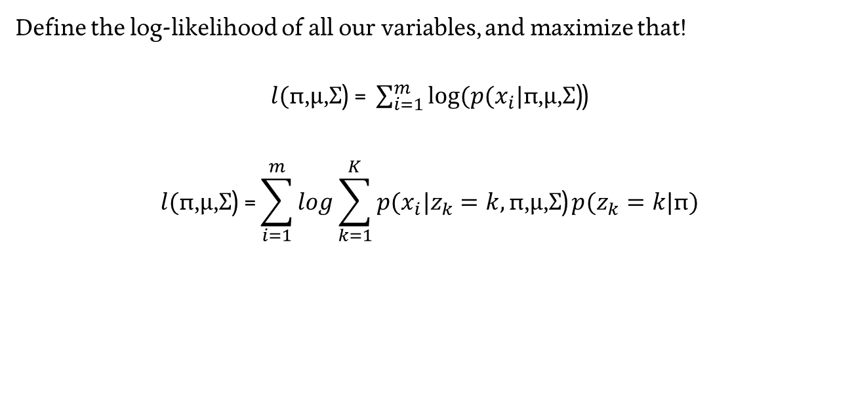
Gaussian Mixture Model – Maximum Likelihood
Define the log-likelihood of all our variables, and maximize that!
$l(\text{π}\text{,}\text{μ}\text{,}\text{Σ}\text{) = }\sum_{i=1}^{m}{log⁡(p(x_{i}|\text{π}\text{,}\text{μ}\text{,}\text{Σ}\text{)}}$)
$$l(\text{π}\text{,}\text{μ}\text{,}\text{Σ}\text{) =}\sum_{i=1}^{m}{log}\sum_{k=1}^{K}{p(x_{i}|z_{k}=k,\text{π}\text{,}\text{μ}\text{,}\text{Σ}\text{)}}p(z_{k}=k|\text{π})$$

Slide 34
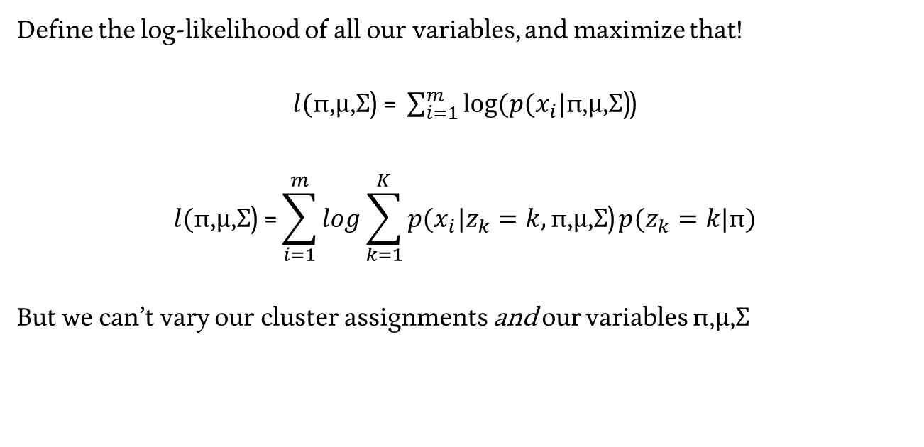
Gaussian Mixture Model – Maximum Likelihood
Define the log-likelihood of all our variables, and maximize that!
$l(\text{π}\text{,}\text{μ}\text{,}\text{Σ}\text{) = }\sum_{i=1}^{m}{log⁡(p(x_{i}|\text{π}\text{,}\text{μ}\text{,}\text{Σ}\text{)}}$)
$$l(\text{π}\text{,}\text{μ}\text{,}\text{Σ}\text{) =}\sum_{i=1}^{m}{log}\sum_{k=1}^{K}{p(x_{i}|z_{k}=k,\text{π}\text{,}\text{μ}\text{,}\text{Σ}\text{)}}p(z_{k}=k|\text{π})$$
But we can’t vary our cluster assignments and our variables $\text{π}\text{,}\text{μ}\text{,}\text{Σ}$

Slide 35
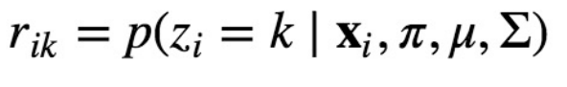
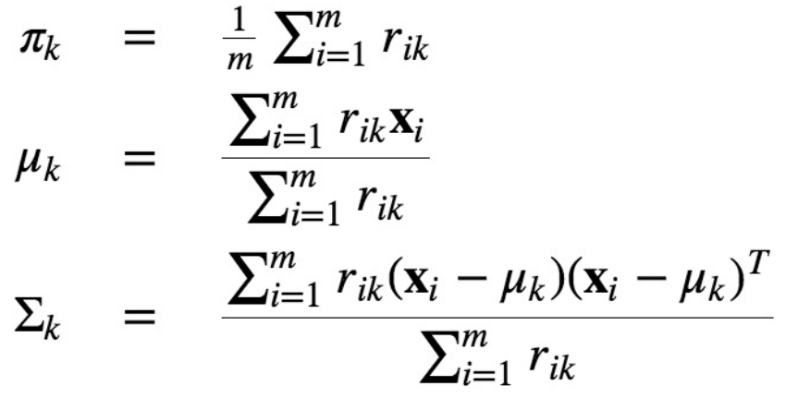
Gaussian Mixture Model – Expectation Maximization
Hold Z fixed, maximize our variables

Slide 36
Gaussian Mixture Model – Expectation Maximization
Hold our cluster definitions fixed, redefine samples to clusters

Slide 37
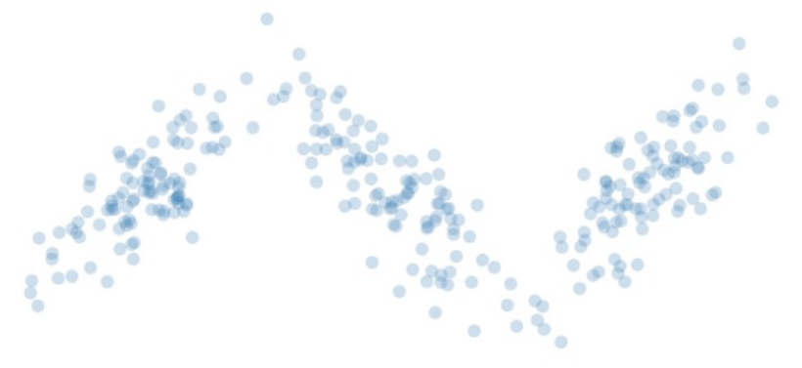
GMM – EM in practice

Slide 38
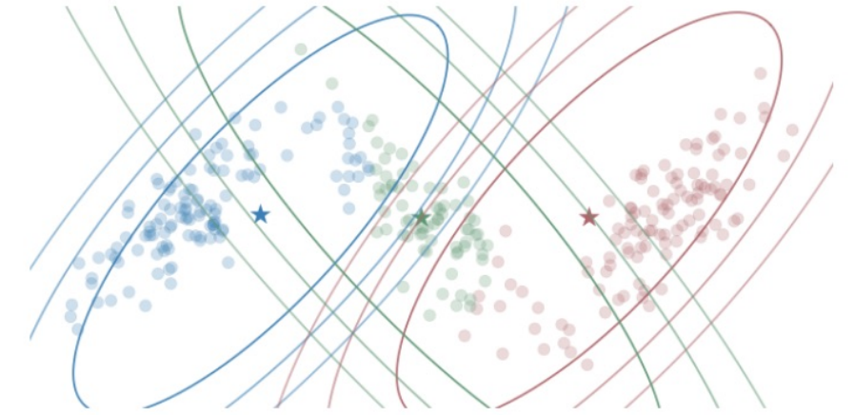
GMM – EM in practice

Slide 39
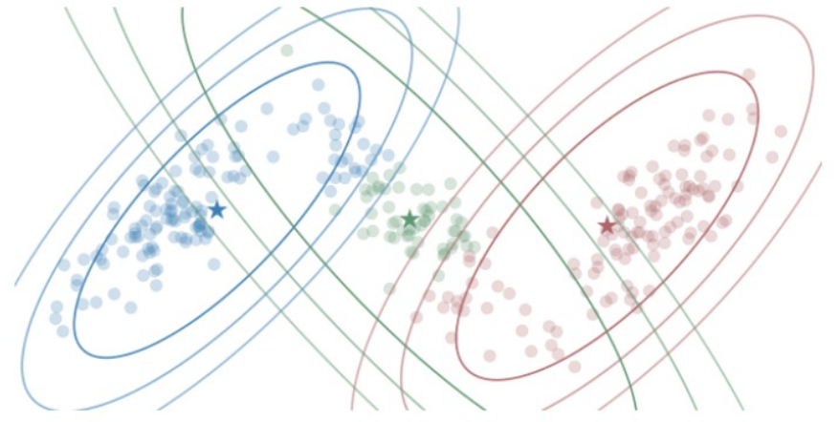
GMM – EM in practice

Slide 40
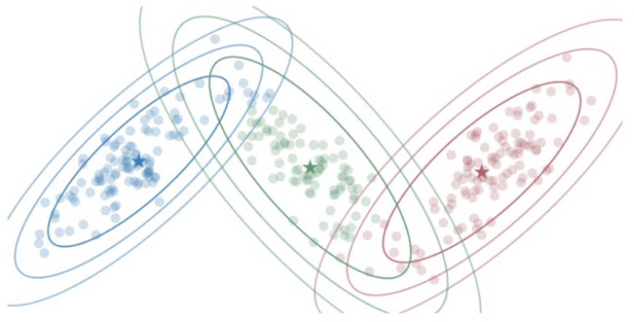
GMM – EM in practice

Slide 41
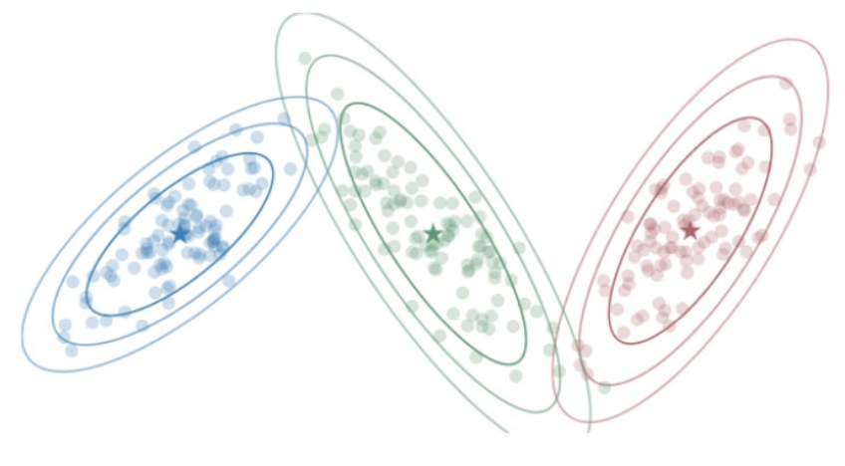
GMM – EM in practice

Slide 42
Principal Components / Singular Value Decomposition

Slide 43
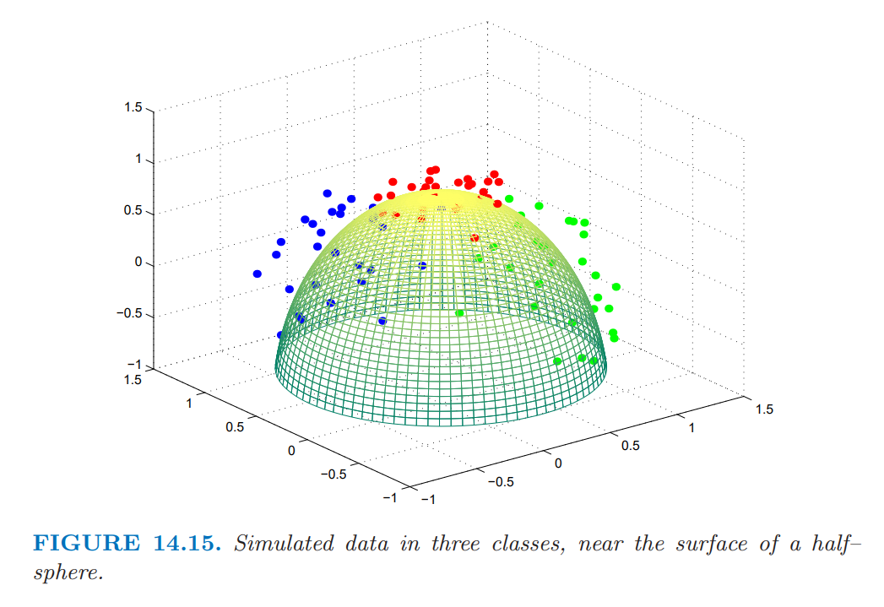
Classification of these data?
Can we predict?
Can we assign?
Can we identify?

Slide 44
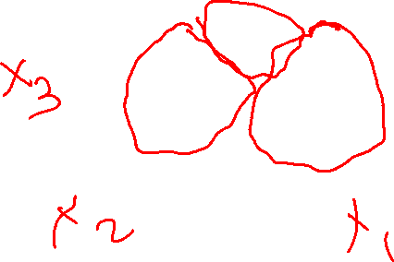
Principal Components – A different objective
What is unique?
What makes an X?

Slide 45
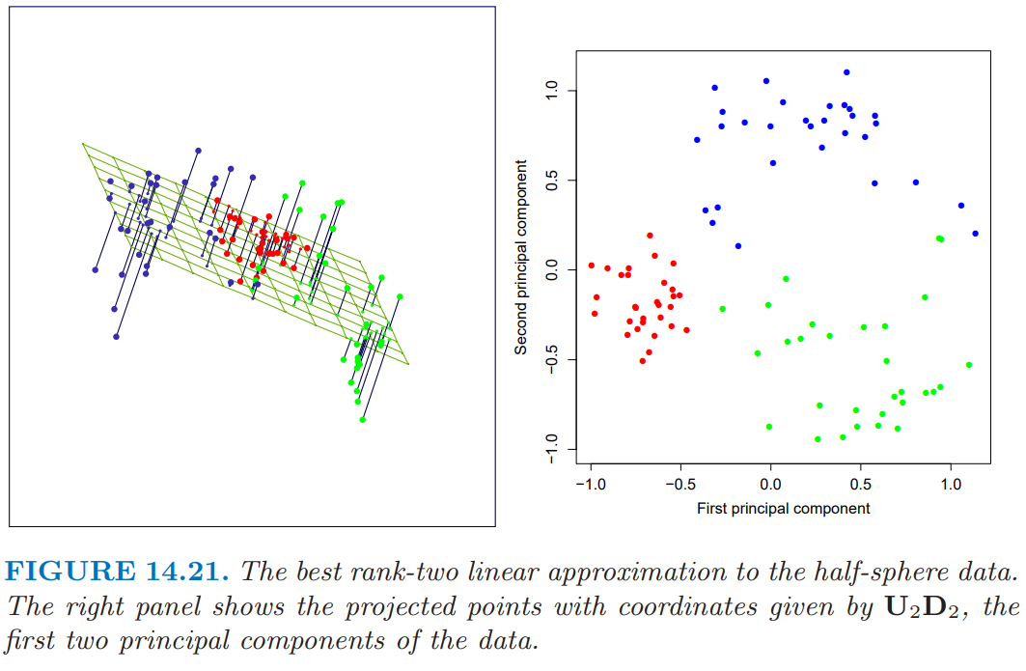
Step 1 – Build a Linear Model Approximation
Implementation details are outlined in ESL Textbook

Slide 46
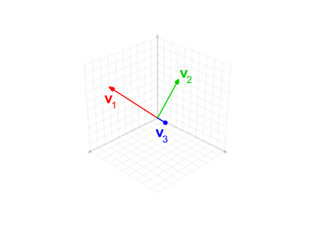

Gram-Schmidt Process

Slide 47
Friday

Slide 48
Course Logistics
Problem Set 5 – Due Friday, April 14
Project Milestone 3 – Due Today!

Slide 49
Step 1 – Build a Linear Model Approximation
Implementation details are outlined in ESL Textbook

Slide 50
Gram-Schmidt Process

Slide 51
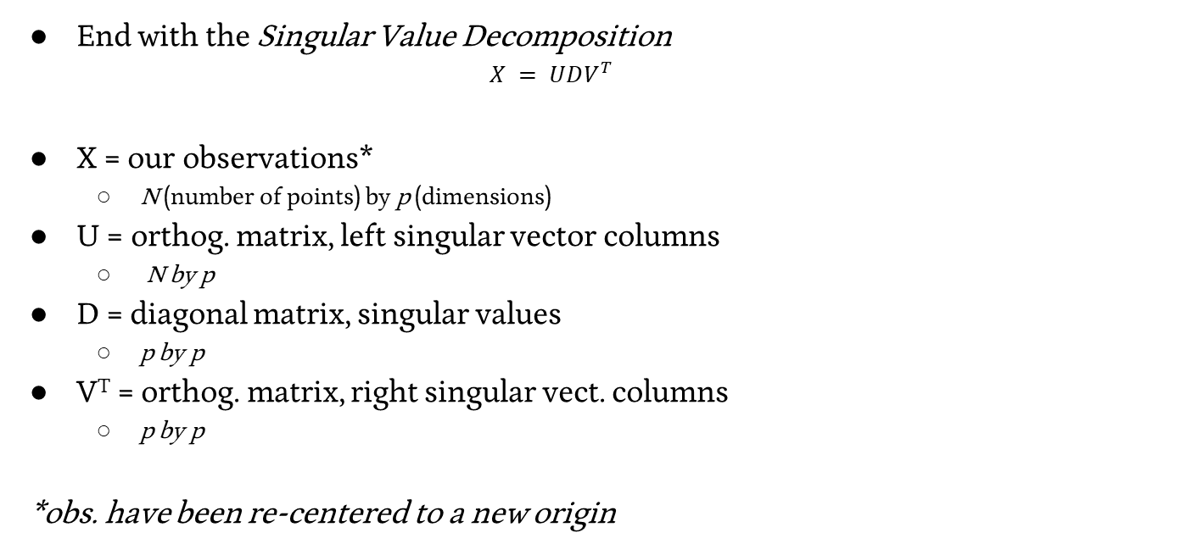
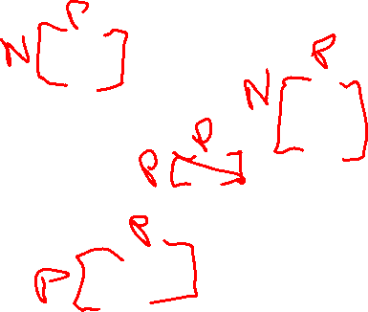
Step 1 – Build a Linear Model Approximation
End with the Singular Value Decomposition
$$X = UDV^{T}$$
X = our observations*
N (number of points) by p (dimensions)
U = orthog. matrix, left singular vector columns
N by p
D = diagonal matrix, singular values
p by p
V^{T} = orthog. matrix, right singular vect. columns
p by p
*obs. have been re-centered to a new origin

Slide 52
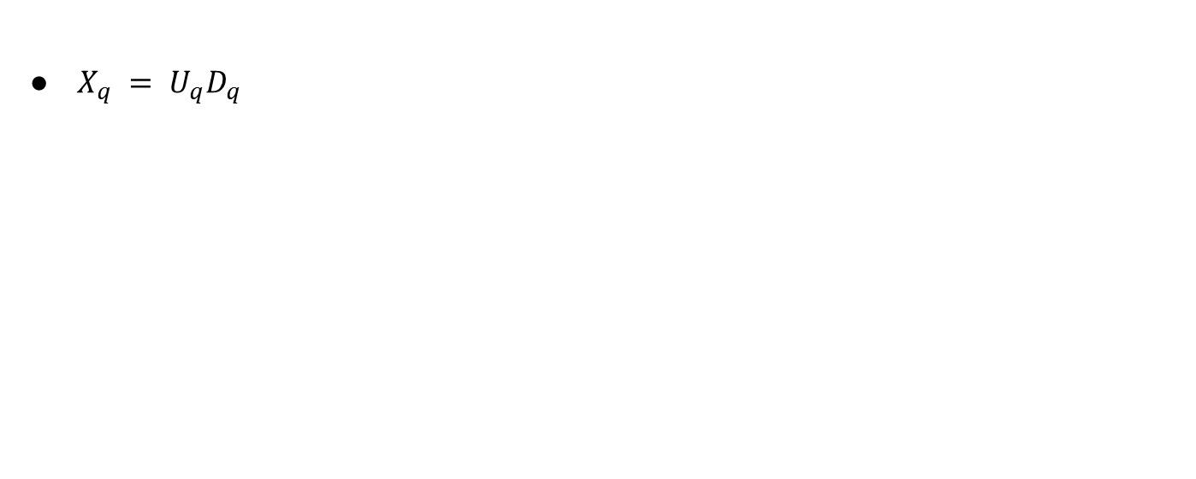

Step 2 – Extract the q principal components you seek
$X_{q} = U_{q}D_{q}$

Slide 53
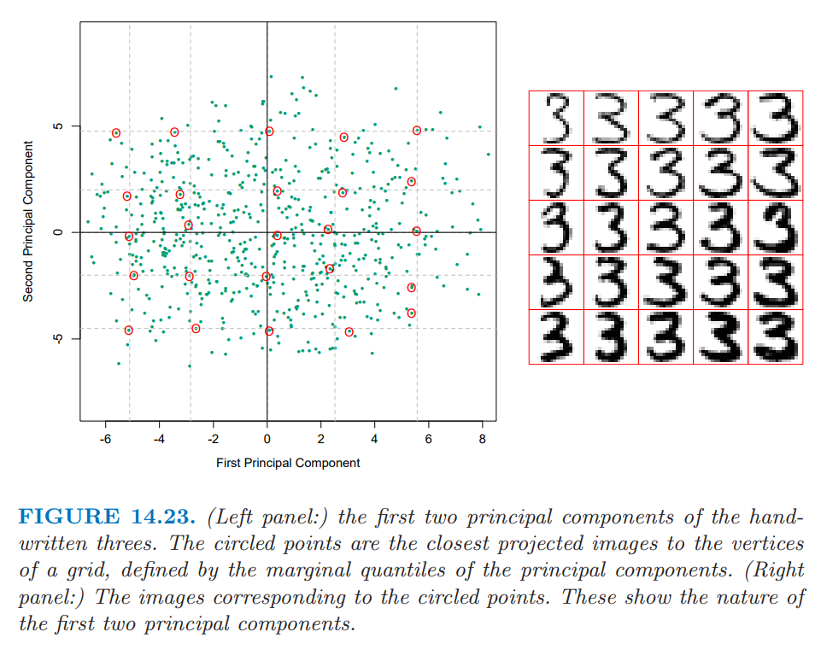
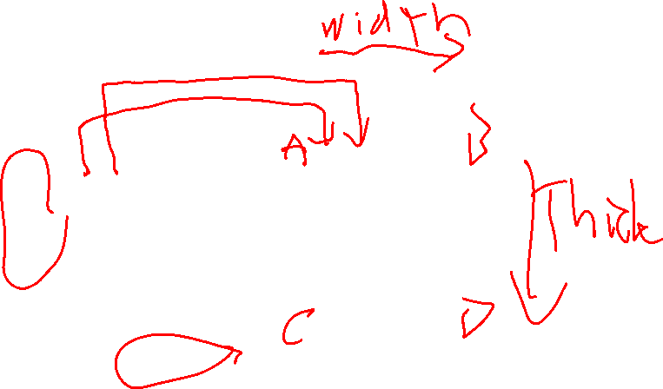
PCA In Action

Slide 54
Was this the best fit?

Slide 55
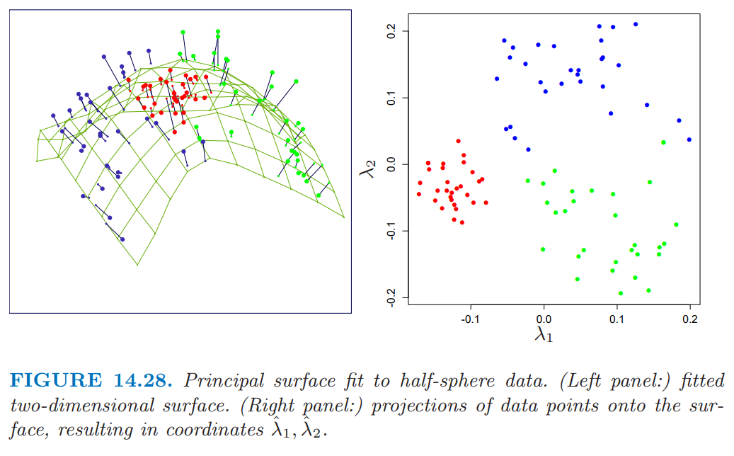
Principal Surface Analysis
End objective – a smoothed curve that best approximates our data

Slide 56
Step 1 - Build a Linear Model Approximation

Slide 57
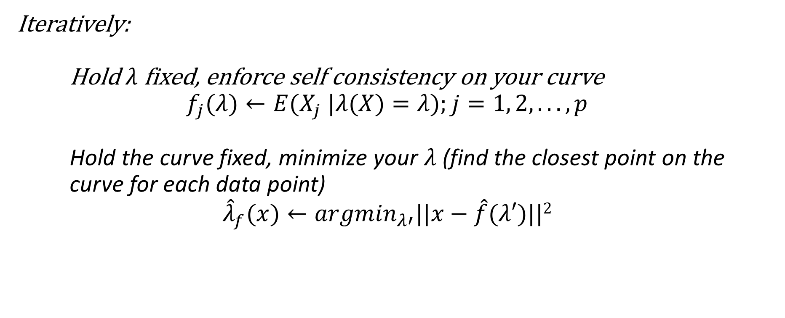
Step 2 – Bend it! (like Beckham?)
Iteratively:
Hold $λ$ fixed, enforce self consistency on your curve
$$f_{j}(λ)←E(X_{j} |λ(X)=λ);j=1, 2, . . . , p$$
Hold the curve fixed, minimize your $λ$ (find the closest point on the curve for each data point)
$${\hat{λ}}_{f}(x)←{argmin}_{λ′}||x−\hat{f}(λ′)||2$$

Slide 58
Principal Surface Analysis
End objective – a smoothed curve that best approximates our data

Slide 59
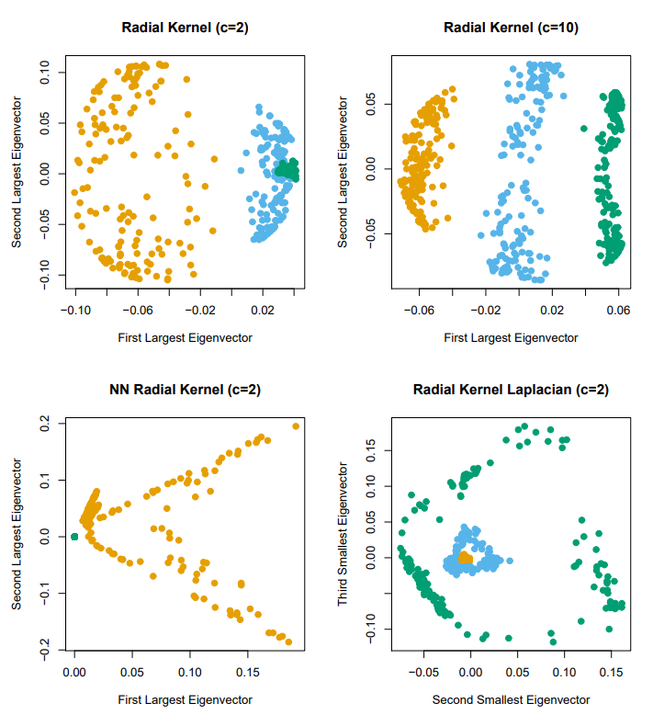
Kernel PCA

Slide 60
NLP Primer - Unsupervised
Or – Everything* You Need To Know About Natural Language Processing
*just kidding – go take 5832 if this sparks your interest!

Slide 61
NLTK – the SKLearn of NLP
https://www.nltk.org/

Slide 62
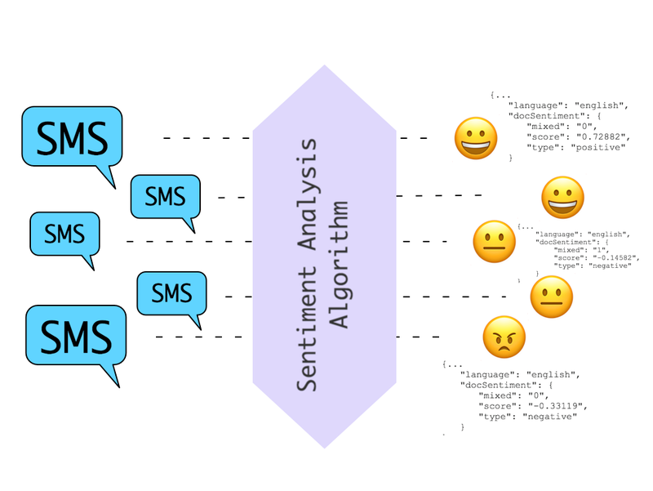
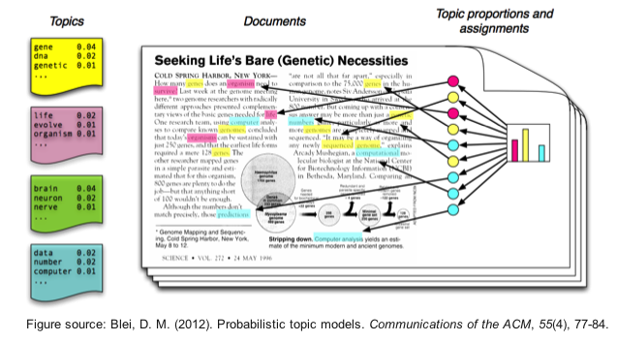

Natural Language Processing – Applications
Sentiment Analysis Topic Modeling
Translation
Notes:
https://machinelearningmastery.com/applications-of-deep-learning-for-natural-language-processing/
https://s3.amazonaws.com/com.twilio.prod.twilio-docs/images/SentimentAnalysis.width-800.png
http://bigdata.ices.utexas.edu/wp-content/uploads/2015/01/LDA-concept.png
https://www.fbi.gov/image-repository/translation-keyboard-stock.jpg/@@images/image/large

Slide 63
Natural Language Processing – Applications
Sentiment Analysis Topic Modeling
Translation
Notes:
https://machinelearningmastery.com/applications-of-deep-learning-for-natural-language-processing/
https://s3.amazonaws.com/com.twilio.prod.twilio-docs/images/SentimentAnalysis.width-800.png
http://bigdata.ices.utexas.edu/wp-content/uploads/2015/01/LDA-concept.png
https://www.fbi.gov/image-repository/translation-keyboard-stock.jpg/@@images/image/large

Slide 64
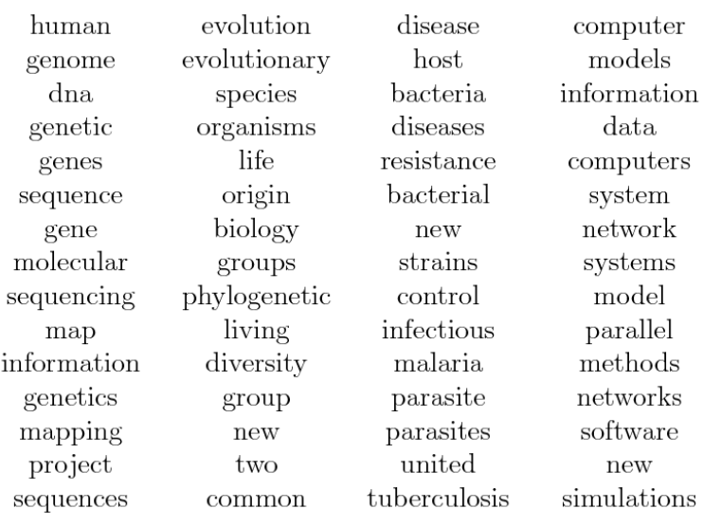
Topic Modeling
Clustering Technique
Associate similar documents
Example: Topics in Science

Slide 65
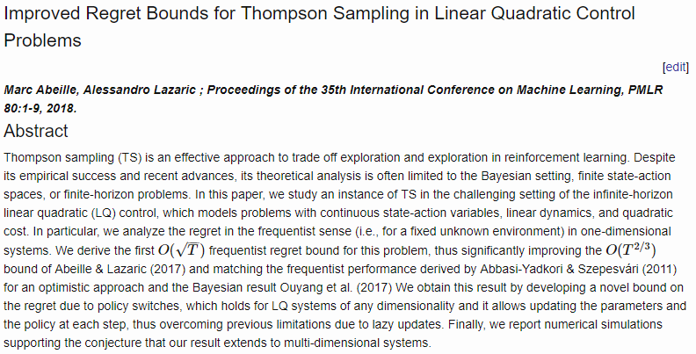
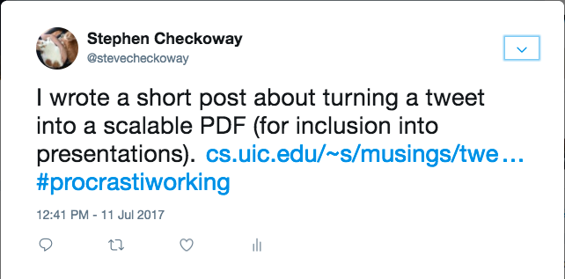
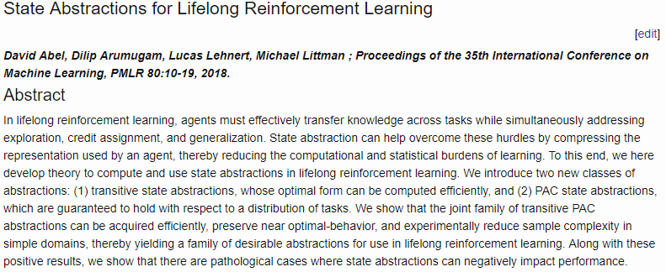

NLP Primer – Documents
Your definition of a “document” may vary, but it’s essentially one example in your problem!
- Tweet
- Article
- Paragraph
- Short-answer Response
Let’s look at clustering tweets
Notes:
https://checkoway.net/assets/posts/tweet-images/tweet.png
https://i0.wp.com/bestlifeonline.com/wp-content/uploads/2018/12/conan-tweet.jpg?fit=498%2C260&ssl=1
http://proceedings.mlr.press/v80/abeille18a.html
http://proceedings.mlr.press/v80/abel18a.html

Slide 66
NLP Primer – Documents into Features
Extracting metadata features
- references (retweets, links, other articles)
- author / source

Slide 67
NLP Primer – Documents into Features
Cleaning & Preparing Text
- Tokenization

Slide 68
NLP Primer – Tokenization
Breaking down block of text into subtexts
Typically filtering out all punctuation
- Or you include it as a token in the series
Notes:
http://blog.xnextcon.com/wp-content/uploads/2018/04/1.jpeg

Slide 69
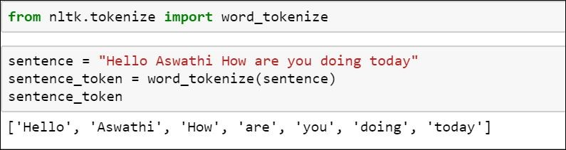
NLP Primer – Tokenization
Breaking down block of text into subtexts
Typically filtering out all punctuation
- Or you include it as a token in the series
May need to retain other structures (e.g. translation)
Notes:
http://blog.xnextcon.com/wp-content/uploads/2018/04/1.jpeg

Slide 70
NLP Primer – Documents into Features
Cleaning & Preparing Text
- Tokenization

Slide 71
NLP Primer – Documents into Features
Cleaning & Preparing Text
- Tokenization
- Removing Unhelpful Words

Slide 72
NLP Primer – Articles & Other Stopwords
Articles – clarifying words on nouns, providing specificity
- I found the bat
- I found a bat
Conjunctions – combining two clauses
- I love everything but sushi
- I love everything and sushi

Slide 73

NLP Primer – Articles & Other Stopwords
Articles – clarifying words on nouns, providing specificity
- I found the bat
- I found a bat
Conjunctions – combining two clauses
- I love everything but sushi
- I love everything and sushi
Notes:
https://i.ytimg.com/vi/AJg0r_b6pYs/maxresdefault.jpg

Slide 74
NLP Primer – Articles & Other Stopwords
Articles – clarifying words on nouns, providing specificity
- I found the bat
- I found a bat
Conjunctions – combining two clauses
- I love everything but sushi
- I love everything and sushi
Your removal needs may vary
- e.g. translation, sentiment
Notes:
https://i.ytimg.com/vi/AJg0r_b6pYs/maxresdefault.jpg

Slide 75
NLP Primer – Documents into Features
Cleaning & Preparing Text
- Tokenization
- Removing Unhelpful Words

Slide 76
NLP Primer – Documents into Features
Cleaning & Preparing Text
- Tokenization
- Removing Unhelpful Words
- Lemmatization & Stemming

Slide 77

Lemmatization & Stemming
Lemmatizing – setting things in a matched tense, person, etc.
- tossed → toss
- ran → run
Stemming – Converting words to their root (stem) word
- tossed → toss
- stemming → stem
Notes:
https://searchingforbole.files.wordpress.com/2018/01/re-learning-english-multiple1.png?w=624

Slide 78

Lemmatization & Stemming
Lemmatizing – setting things in a matched tense, person, etc.
- tossed → toss
- ran → run
Stemming – Converting words to their root (stem) word
- tossed → toss
- stemming → stem
Notes:
https://www.guru99.com/images/1/100118_0649_Stemmingand2.png

Slide 79
Lemmatization & Stemming
Lemmatizing – setting things in a matched tense, person, etc.
- tossed → toss
- ran → run
Stemming – Converting words to their root (stem) word
- tossed → toss
- stemming → stem
Your needs may vary
- translation
Notes:
https://www.guru99.com/images/1/100118_0649_Stemmingand2.png

Slide 80

NLP Primer – Documents into Features
A words array for each entry

Slide 81
NLP – Analysis Approaches
Bag-of-words – each document is just a collection of words, dropping all reference to order, etc.

Slide 82
NLP – Analysis Approaches
Bag-of-words – each document is just a collection of words, dropping all reference to order, etc.
N-Gram Models – Each set of N words is treated as an entry

Slide 83

Topic Modeling – Vectors to Matrix
Words array for each entry → <Documents> X <Words> Matrix
Documents Doc ID
0 1 … n-1 n
Words $\begin{matrix}\begin{matrix}base \\ bat\end{matrix} \\ … \\ \begin{matrix}cause \\ missile\end{matrix}\end{matrix}$ $\left[\begin{matrix}\begin{matrix}1 & 2 \\ 0 & 5\end{matrix} & ⋯ & \begin{matrix}9 & 0 \\ 0 & 0\end{matrix} \\ ⋮ & ⋱ & ⋮ \\ \begin{matrix}8 & 6 \\ 0 & 4\end{matrix} & ⋯ & \begin{matrix}1 & 3 \\ 0 & 4\end{matrix}\end{matrix}\right]$

Slide 84


Adjusting the Matrix – TF-IDF
term frequency-inverse document frequency
Notes:
https://medium.com/nanonets/topic-modeling-with-lsa-psla-lda-and-lda2vec-555ff65b0b05

Slide 85
Wednesday

Slide 86
Weekly Updates
PS5 due Friday
Project Milestone 4 – to be released

Slide 87
Natural Language Processing – Applications
Sentiment Analysis Topic Modeling
Translation
Notes:
https://machinelearningmastery.com/applications-of-deep-learning-for-natural-language-processing/
https://s3.amazonaws.com/com.twilio.prod.twilio-docs/images/SentimentAnalysis.width-800.png
http://bigdata.ices.utexas.edu/wp-content/uploads/2015/01/LDA-concept.png
https://www.fbi.gov/image-repository/translation-keyboard-stock.jpg/@@images/image/large

Slide 88
NLP Primer – Documents into Features
Cleaning & Preparing Text
- Tokenization
- Removing Unhelpful Words
- Lemmatization & Stemming

Slide 89

NLP – Analysis Approaches
Bag-of-words – each document is just a collection of words, dropping all reference to order, etc.
N-Gram Models – Each set of N words is treated as an entry

Slide 90
Topic Modeling – Vectors to Matrix
Words array for each entry → <Documents> X <Words> Matrix
Documents Doc ID
0 1 … n-1 n
Words $\begin{matrix}\begin{matrix}base \\ bat\end{matrix} \\ … \\ \begin{matrix}cause \\ missile\end{matrix}\end{matrix}$ $\left[\begin{matrix}\begin{matrix}1 & 2 \\ 0 & 5\end{matrix} & ⋯ & \begin{matrix}9 & 0 \\ 0 & 0\end{matrix} \\ ⋮ & ⋱ & ⋮ \\ \begin{matrix}8 & 6 \\ 0 & 4\end{matrix} & ⋯ & \begin{matrix}1 & 3 \\ 0 & 4\end{matrix}\end{matrix}\right]$

Slide 91
Adjusting the Matrix – TF-IDF
term frequency-inverse document frequency
Notes:
https://medium.com/nanonets/topic-modeling-with-lsa-psla-lda-and-lda2vec-555ff65b0b05

Slide 92

Topic Modeling – Vectors to Matrix
<Documents> X <Words> Matrix
Documents
0 1 … n-1 n
Words (TF-IDF) $\begin{matrix}\begin{matrix}base \\ bat\end{matrix} \\ … \\ \begin{matrix}cause \\ missile\end{matrix}\end{matrix}$ $\left[\begin{matrix}\begin{matrix}1.2 & .004 \\ 0 & .01\end{matrix} & ⋯ & \begin{matrix}78.2 & 0 \\ 0 & 0\end{matrix} \\ ⋮ & ⋱ & ⋮ \\ \begin{matrix}99.3 & .013 \\ 0 & .009\end{matrix} & ⋯ & \begin{matrix}3.2 & 7.5 \\ 0 & 9.2\end{matrix}\end{matrix}\right]$

Slide 93

Topic Modeling – Vectors to Matrix
<Documents> X <Words> Matrix
Documents
0 1 … n-1 n
Words (TF-IDF) $\begin{matrix}\begin{matrix}base \\ bat\end{matrix} \\ … \\ \begin{matrix}cause \\ missile\end{matrix}\end{matrix}$ $\left[\begin{matrix}\begin{matrix}1.2 & .004 \\ 0 & .01\end{matrix} & ⋯ & \begin{matrix}78.2 & 0 \\ 0 & 0\end{matrix} \\ ⋮ & ⋱ & ⋮ \\ \begin{matrix}99.3 & .013 \\ 0 & .009\end{matrix} & ⋯ & \begin{matrix}3.2 & 7.5 \\ 0 & 9.2\end{matrix}\end{matrix}\right]$
You could scale these!

Slide 94

Topic Modeling – Matrix to Topics
Matrix Representation of Documents & Terms

Slide 95
Topic Modeling – Matrix to Topics
Matrix Representation of Documents & Terms
Think of this as a generative process – Terms → Topics → Documents

Slide 96
Topic Modeling – Matrix to Topics
Matrix Representation of Documents & Words
Think of this as a generative process – Words → Topics → Documents
Docs X Words Topics X Words Topics Docs X Topics

Slide 97
Topic Modeling - SVD
SVD transforms our matrix A’ into it’s constituent parts

Slide 98

Latent Semantic Analysis (LSA) in SKLearn
https://medium.com/nanonets/topic-modeling-with-lsa-psla-lda-and-lda2vec-555ff65b0b05

Slide 99
Ethics in Machine Learning
i.e. Everything You Need To Know About Being Good
Notes:
https://www.colorado.edu/philosophy/2018/11/02/new-course-ethics-and-information-technology-phil-2160

Slide 100
Ethics in Machine Learning
i.e. Everything You Need To Know About Being Good
PHIL 2160 or ???
Notes:
https://www.colorado.edu/philosophy/2018/11/02/new-course-ethics-and-information-technology-phil-2160

Slide 101
Ethics Discussion Disclaimer
This is an inherently personal and interpersonal topic
Personal ideals, beliefs, and understandings of truth come into play
I will try to be unbiased, present different ideas and facts
I may, from time to time, take extreme / indefensible views to foster discussion
This is an open space for disagreement and discussion
Discuss issues that are sometimes sensitive – but avoid arguments or direct use of offensive language
This is a sensitive and difficult set of topics to discuss
Warning: We will be discussing death, racism, hate speech, and other topics

Slide 102

Moral Theories
Divine Command
- Ethics are mandated by divine
- Saint Augustine
Utilitarianism
- Ethics are related to the consequences
- Henry Sidgwick
Virtue Ethics
- Ethics are internal motivation
- Elizabeth Anscombe
Deontology
- Ethics are a shared set of rules
- Immanuel Kant
http://existentialcomics.com/comic/258

Slide 103

Case Study 1 – Boeing 737 MAX Crashes
Notes:
https://www.bbc.com/news/world-africa-47553174

Slide 104

Notes:
https://www.reuters.com/article/us-ethiopia-airplane-regulator-insight/regulators-knew-before-crashes-that-737-max-trim-control-was-confusing-in-some-conditions-document-idUSKCN1RA0DP

Slide 105


Slide 106

Notes:
https://www.bbc.com/news/world-africa-47553174

Slide 108

Case Study 1 – Boeing 737 MAX Crashes
Thoughts?
Who is responsible?
How can this inform your actions?

Slide 109
Ethics vs. Morals vs. Laws
Law – Minimum societal standards for behavior
Ethics – The answers to “What should I do?”
Morals – A cohesive structure for ethics
https://ethics.org.au/ethics-morality-law-whats-the-difference/

Slide 110

Case Study 2 – Chat Bots
https://www.nytimes.com/2016/03/25/technology/microsoft-created-a-twitter-bot-to-learn-from-users-it-quickly-became-a-racist-jerk.html

Slide 111

Case Study 2 – Chat Bots
https://www.businessinsider.com/microsoft-deletes-racist-genocidal-tweets-from-ai-chatbot-tay-2016-3?r=UK&IR=T

Slide 112
Case Study 2 – Chat Bots
Best Uses of ChatGPT
1. Ability to Understand and Respond to a Wide Range of Language Inputs
2. Ability to Learn and Improve Over Time
3. Answer Questions
4. Improved Interpretability
5. Alternative to Google Search
6. Use AI to Write High-Performing Copy
7. Education or Training Purposes
8. Create a Virtual Assistant
https://emeritus.org/blog/ai-and-ml-chatgpt-use-cases/ (First Google Result)

Slide 113

Bing is having problems…
Misunderstandings…

Slide 114


Bing is having problems…
Errors…

Slide 115
Bing is having problems…
Contradictions…

Slide 116

Bing is having problems…
Defensiveness…

Slide 117


Bing is having problems…
Shutting Down…

Slide 118
Friday

Slide 119
Weekly Updates
PS5 due Friday
Project Milestone 4 – Up!

Slide 120
Ethics Discussion Disclaimer
This is an inherently personal and interpersonal topic
Personal ideals, beliefs, and understandings of truth come into play
I will try to be unbiased, present different ideas and facts
I may, from time to time, take extreme / indefensible views to foster discussion
This is an open space for disagreement and discussion
Discuss issues that are sometimes sensitive – but avoid arguments or direct use of offensive language
This is a sensitive and difficult set of topics to discuss
Warning: We will be discussing death, racism, hate speech, and other topics

Slide 121
Case Study 2 – Chat Bots
https://www.nytimes.com/2016/03/25/technology/microsoft-created-a-twitter-bot-to-learn-from-users-it-quickly-became-a-racist-jerk.html

Slide 122
Bing is having problems…
Shutting Down…

Slide 123

Case Study 2 – Chat Bots
Thoughts?
Who is responsible?
How might this inform your actions?

Slide 124



Case Study 2a – Russian Bots in US Election
Russian agencies
https://www.justice.gov/storage/report.pdf

Slide 125
Case Study 2a – Russian Bots in US Election
Is this Illegal? Immoral? Unethical?

Slide 126
Case Study 2b – Russian Bots in Russia
This section is pulling from research and results from before 2022
Current events, such as the war (“Special Action”) in Ukraine are not reflected in the issues I am presenting.
These topics are still relevant to our discussion

Slide 127

Case Study 2b – Russian Bots in Russia
http://www.ponarseurasia.org/memo/use-twitter-bots-russian-political-communication

Slide 128
Case Study 2b – Russian Bots in Russia
Is this any different?

Slide 129
Case Study 2b – Russian Bots in Russia
Is this any different?
- If it’s internal to your own country?

Slide 130
Case Study 2b – Russian Bots in Russia
Is this any different?
- If it’s internal to your own country?
- If “all” perspectives are represented?

Slide 131
Institutional Review Board (IRB)
Oversees human subjects research
Research projects undergo review by staff for moral / ethical concerns
https://www.colorado.edu/researchinnovation/irb

Slide 132

Belmont Report
Respect for persons - requires that research subjects are not coerced into participating in a study and requires the protection of research subjects who have diminished autonomy
Beneficence - requires that experiments do not harm research subjects, and that researchers minimize the risks for subjects while maximizing the benefits for them
Justice - requires that all forms of differential treatment among research subjects be justified
24" X 36"
24" X 36"

Slide 133
Monday

Slide 134
Weekly Updates
PS6 due Friday, April 28
PS7 from April 28 to “Wednesday, May 3”
Project Milestone 4 – Up!
TBD on Poster Printing
Exam 2 – Monday 4/24

Slide 135
Ethics Discussion Disclaimer
This is an inherently personal and interpersonal topic
Personal ideals, beliefs, and understandings of truth come into play
I will try to be unbiased, present different ideas and facts
I may, from time to time, take extreme / indefensible views to foster discussion
This is an open space for disagreement and discussion
Discuss issues that are sometimes sensitive – but avoid arguments or direct use of offensive language
This is a sensitive and difficult set of topics to discuss
Warning: We will be discussing death, racism, hate speech, and other topics

Slide 136

Case Study 3 - An “ideal.” model of AI in Recruitment?
https://ideal.com/ai-recruitment/

Slide 137
Case Study 3 - An “ideal.” model of AI in Recruitment?
https://ideal.com/ai-recruitment/

Slide 138
Case Study 3 - An “ideal.” model of AI in Recruitment?
https://ideal.com/ai-recruitment/

Slide 139
Case Study 3 - An “ideal.” model of AI in Recruitment?
https://ideal.com/ai-recruitment/

Slide 140

Automated Hiring – Learning Biases
https://www.reuters.com/article/us-amazon-com-jobs-automation-insight/amazon-scraps-secret-ai-recruiting-tool-that-showed-bias-against-women-idUSKCN1MK08G

Slide 141
Case Study 4 – Automated Hiring
Thoughts?
What threats are there?
How might this inform your actions?

Slide 142
Thinking it Through: tf-idf
How is tf-idf (term frequency-inverse document frequency) going to behave on a generic resume?
How can we address these concerns?

Slide 143

The “Gold Standard” – Human Performance
Sample | Document | Qualified?
1 | [‘CU Boulder’ …] | 1
2 | [‘Metro’ …] | 0
3 | [‘CU Boulder’ …] | 1
4 | [‘CSU’ …] | 1
Notes:
https://image1.masterfile.com/getImage/NjQwLTAzMjY0NDE3ZW4uMDAwMDAwMDA=ANfdEp/640-03264417en_Masterfile.jpg

Slide 144
The “Gold Standard” – A Limit to Success
Sample | Document | Qualified?
1 | [‘CU Boulder’ …] | 1
2 | [‘Metro’ …] | 0
3 | [‘CU Boulder’ …] | 1
4 | [‘CSU’ …] | 1
Loss in Encoding
Sample | Document | Qualified?
1 | [‘CU Boulder’ …] | 1
2 | [‘Metro’ …] | 0
3 | [‘CU Boulder’ …] | 0
4 | [‘CSU’ …] | 1
Inaccuracies Carry Over to ML
Additional Loss in Training
Notes:
https://image1.masterfile.com/getImage/NjQwLTAzMjY0NDE3ZW4uMDAwMDAwMDA=ANfdEp/640-03264417en_Masterfile.jpg

Slide 145
Trying to “unlearn” bias
Upsampling & Downsampling
From your initial dataset, use a repeated sampling method to “add examples” of your minority case to reach equal groups. (Or only subsample your majority case)
Add “noise” to your samples to (help) avoid overfitting.

Slide 146
Trying to “unlearn” bias
Upsampling & Downsampling
From your initial dataset, use a repeated sampling method to “add examples” of your minority case to reach equal groups. (Or only subsample your majority case)
Add “noise” to your samples to (help) avoid overfitting.
 | Hired | Not Hired
Male | N samples | N samples
Female | N samples | N samples

Slide 147
Trying to “unlearn” bias
Upsampling & Downsampling
From your initial dataset, use a repeated sampling method to “add examples” of your minority case to reach equal groups. (Or only subsample your majority case)
Add “noise” to your samples to (help) avoid overfitting.
 | Hired | Not Hired
Male | N samples | N samples
Female | N samples | N samples
NB | N samples? | N samples?

Slide 148
Trying to “unlearn” bias
Upsampling & Downsampling
From your initial dataset, use a repeated sampling method to “add examples” of your minority case to reach equal groups. (Or only subsample your majority case)
Add “noise” to your samples to (help) avoid overfitting.
Variable Transformation / Removal
Remove features that are (or you suspect to be) associated with bias
e.g. Remove gender and racial identifying content

Slide 149

Trying to “unlearn” bias
Variable Transformation / Removal
Remove features that are (or you suspect to be) associated with bias
e.g. Remove gender and racial identifying content
Identify all gender-associated content in this resume snippet:
David Quigley
Education:
PhD – University of Colorado Boulder
- Captured K-12 learner’s experiences with digital tools.
…

Slide 150
Trying to “unlearn” bias
Variable Transformation / Removal
Remove features that are (or you suspect to be) associated with bias
e.g. Remove gender and racial identifying content
Identify all gender-associated content in this resume snippet:
David Quigley
Education:
PhD – University of Colorado Boulder
- Captured K-12 learner’s experiences with digital tools.
…

Slide 151
Trying to “unlearn” bias
Variable Transformation / Removal
Remove features that are (or you suspect to be) associated with bias
e.g. Remove gender and racial identifying content
Identify all gender-associated content in this resume snippet:
David Quigley
Education:
PhD – University of Colorado Boulder
- Captured K-12 learner’s experiences with digital tools.
…

Slide 152

Trying to “unlearn” bias
Variable Transformation / Removal
Remove features that are (or you suspect to be) associated with bias
e.g. Remove gender and racial identifying content
Identify all gender-associated content in this resume snippet:
David Quigley
Education:
PhD – University of Colorado Boulder
- Captured K-12 learner’s experiences with digital tools.
…

Slide 153
Wednesday

Slide 154
Weekly Updates
PS6 due Friday, April 28
PS7 from April 28 to “Wednesday, May 3”
Project Milestone 4 – Up!
Poster Printing through InkSpot
Needs to be in by Wednesday! Pick it up by 5PM Friday and they want 2 days lead time.
Exam 2 – Monday 4/24

Slide 155
Trying to “unlearn” bias
Variable Transformation / Removal
Remove features that are (or you suspect to be) associated with bias
e.g. Remove gender and racial identifying content
Identify all gender-associated content in this resume snippet:
David Quigley
Education:
PhD – University of Colorado Boulder
- Captured K-12 learner’s experiences with digital tools.
…

Slide 156

Machine Learning (Often) Captures Correlation
https://www.ibpsychmatters.com/why-correlation-is-not-causation
https://en.wikipedia.org/wiki/Spurious_relationship

Slide 157
Machine Learning (Often) Captures Correlation
Is this always a bad thing?

Slide 158
Interlude
Reinforcement Learning on PS6

Slide 159

Frozen Lake Environment

Slide 160

Developing Q – Updating Value (Week 11)
Calculate out the probability of success or failure at each point
Notes:
https://www.cin.ufpe.br/~tfl2/artificial-intelligence-modern-approach.9780131038059.25368.pdf

Slide 161
Value Iteration

Slide 162

Scale – Monte Carlo Estimation
Instead of mapping out the full probability space, let’s generate a bunch of sample uses of our policy (to end-state) and use the outcomes to determine value!
Notes:
https://thumbs.gfycat.com/BetterThankfulEnglishsetter-max-1mb.gif

Slide 163


Developing Q – Monte Carlo

Slide 164
AutoML (auto-sklearn)

Slide 165
Finding the Right Model
Trying a bunch out!
Using your knowledge / expectations to choose appropriate models to try

Slide 166
Finding the Right Hyperparameters
(How many K for KNN? What Penalty Function should we use? What Learning Rate?)
Trying a bunch out!
Using your knowledge / expectations to choose appropriate models to try

Slide 167
Finding the Right Hyperparameters
(How many K for KNN? What Penalty Function should we use? What Learning Rate?)
Trying a bunch out!
Trying random values for hyperparameters (Random Search)
Trying values systematically (Grid Search)
Using your knowledge / expectations to choose appropriate models to try
Constrain your trials

Slide 168
CASH Problem
(C)ombined (A)lgorithm (S)elction and (H)yperparameter optimization
What Algorithm X should I use? What Hyperparameters optimize Model X?

Slide 169



Optimization
$y=x^{2}∗{sin⁡(5πx)}^{6}$
How can we estimate this function?

Slide 170

Bayes Rule (Refresh)
$P\left(A | B\right)=\frac{P\left(B | A\right)∗P\left(A\right)}{P(B)}$ (Posterior = Likelihood * Prior / Evidence)
$P\left(A | B\right)=P\left(B | A\right)∗P\left(A\right)$ (We drop the Evidence term, thinking of relationships between different A values)

Slide 171

Bayes Rule (Refresh)
$P\left(A | B\right)=\frac{P\left(B | A\right)∗P\left(A\right)}{P(B)}$ (Posterior = Likelihood * Prior / Evidence)
$P\left(A | B\right)=P\left(B | A\right)∗P\left(A\right)$ (We drop the Evidence term, thinking of relationships between different A values)
Bayesian Optimization
$P\left(f | X\right)=P\left(X | f\right)∗P\left(f\right)$

Slide 172

Bayesian Optimization
$P\left(f | X\right)=P\left(X | f\right)∗P\left(f\right)$
Objective Function: Mapping from sample to “cost” (i.e. how closely we fit)
Note: We don’t have the true objective function – it is what we are trying to find!
Surrogate Function: Approximation of the Objective Function
Our Posterior acts as a Surrogate Function!
Acquisition Function: Method for choosing a Sample to Optimize

Slide 173
Surrogate Function
Model the inputs to your Cost / Score
Either a Random Forest or a Gaussian Process
Supports diverse, high-dimensional data Supports Normal (Gaussian) features

Slide 174

Surrogate Function Results

Slide 175
Acquisition Function
Sample the true point
How likely is this point to allow me to improve my model?
Probability of Improvement
Expected Improvement
Lower Confidence Bound

Slide 176
Bayesian Optimization
Select a Sample
Use your Acquisition Function to find the Optimal Sample
Evaluate the Sample via the Objective Function
Update the Data & Surrogate Function

Slide 177

Bayesian Optimization vs. Objective Function
VS

Slide 178


Insert AutoML!

Slide 179
Meta-Learning
How well will ML Model X perform on my problem?

Slide 180
Meta-Learning
How well will ML Model X perform on my problem?
How well did ML Model X work on other problem A?
How similar is Problem A to my problem?

Slide 181
Ensemble Construction
Build a bunch of sub-optimal classifiers
Listen to the wisdom of the crowd!

Slide 182
Ensemble Construction - AutoML
Build a bunch of sub-optimal classifiers
Choose classifiers that make unique observations
Errors for models should be uncorrelated
Listen to the wisdom of the crowd!

Slide 183
AutoML – The biggest timesink
As expected, the AutoML process takes time.

Slide 184

AutoML – The biggest timesink

Slide 185
AutoML – Cool and useful, but is it perfect?

Slide 186
AutoML – Cool and useful, but is it perfect?
Pros
Allows us to blindly find a well-fit model
Provides details about models, execution, etc.
Cons
Takes a loooooong time to run
Uses a greedy approach to build & select models
Note: This is partly specific to auto-sklearn in particular

Slide 187
Friday

Slide 188
Weekly Updates
PS6 due Friday, April 28
PS7 from April 28 to “Wednesday, May 3”
Project Milestone 4 – Up!
Poster Printing through InkSpot
Needs to be in by Wednesday! Pick it up by 5PM Friday and they want 2 days lead time.
Exam 2 – Monday 4/24

Slide 189


Exam 2 Poll

Slide 190
Neural Nets

Slide 191

Neural Networks - Notation
$$l=layer (from 1 to L)$$
$$b^{l}=vector of bias inputs for l+1$$
$$b_{i}^{l}=bias value, layer l, node i$$
$$W^{l}=matrix of weights for l+1$$
$$w_{ji}^{l}=weigh value, layer l, nodes j to i$$
$$z^{l+1}=W^{l}a^{l}+b^{l}$$
$$a^{l+1}=g(z^{l+1})$$
ŷ = a^{L}

Slide 192
The Multi-layer Perceptron
INPUT LAYER HIDDEN LAYER OUTPUT LAYER
$$W^{1}=\left[\begin{matrix}w_{11}^{1} & w_{12}^{1} \\ w_{21}^{1} & w_{22}^{1}\end{matrix}\right], b^{1}=\left[\begin{matrix}b_{1}^{1} \\ b_{2}^{1}\end{matrix}\right]$$
Intermediate Activities z
$$z^{2}=W^{1}x^{1}+b^{1}$$
Intermediate Activations a
$$a^{2}=g(z^{2})$$
1
1
$$b_{1}^{1}$$
$$b_{1}^{2}$$
a₁
Y₁
X₁
$$w_{11}^{1}$$
$$w_{11}^{2}$$
1 or -1
$$w_{21}^{1}$$
$$w_{21}^{2}$$
$$b_{2}^{1}$$
$$w_{12}^{1}$$
a₂
X₂
$$w_{22}^{1}$$

Slide 193

Decision Boundaries
https://www.v7labs.com/blog/neural-networks-activation-functions

Slide 194
Neural Networks – Learning the Weights
Define a Loss Function $C\left(x,y,W,b\right)$
$$Classification=−\sum_{k=1}^{m}{y_{k}\log\left({\hat{y}}_{k}\right)+\left(1 −y_{k}\right)\log\left(1−{\hat{y}}_{k}\right)}$$
$$Regression=\frac{1}{2}\sum_{k=1}^{m}{{(y}_{k}−{\hat{y}}_{k})2}$$

Slide 195
Neural Networks – Learning the Weights
Gradient Descent!
$w_{ij}^{l}$ = $w_{ij}^{l}−\text{η}\frac{∂C}{∂w_{ji}^{l}}$
$b_{i}^{l}$ = $b_{i}^{l}−\text{η}\frac{∂C}{∂b_{i}^{l}}$

Slide 196

Computing the Partial Derivatives - Practice
$$derivative of f with respect to s=\frac{∂f}{∂s}=\frac{∂f}{∂x}\frac{∂x}{∂s}+\frac{∂f}{∂y}\frac{∂y}{∂s}+\frac{∂f}{∂z}\frac{∂z}{∂s}$$
$$f=xyz$$
$$x=r$$
$$y=rs$$
$$z=s$$
$$\frac{∂f}{∂s}=yz∗0+xz∗r+xy ∗1$$
$$\frac{∂f}{∂s}=rs^{2}∗0+rs∗r+r^{2}s ∗1$$
$$\frac{∂f}{∂s}=2r^{2}s$$

Slide 197
Back Propagation – General Algorithm
Compute $\text{δ}$ for the output layer L
$${\text{δ}}^{L}={\text{▽}}_{a^{L}}\text{C}\text{ ⊙} g′(z^{L})$$
$for l=L$-1, ... 2
Compute the Weight Derivatives
$$\frac{∂C}{∂w^{l}}={\text{δ}}^{l+1}{{(a}^{l})}^{T}$$
compute the Bias Derivatives
$$\frac{∂C}{∂b^{l}}={\text{δ}}^{l+1}$$
back-propagate to previous layer
$${\text{δ}}^{l}={(W^{l})}^{T}{\text{δ}}^{l+1}\text{⊙}g^{′}\left(z^{l}\right)$$

Slide 198
Outstanding Issues with Neural Networks
Starting Values
Standard SGD Issues – Local vs. Global Minimum
Stopping Point

Slide 199
Neural Networks – Initializing Weights
1
1
b¹
b²
Initialize with all 0s?
Locks Up
Initialize with all 1s?
Works fine…
Initialize with small random weights?
Works better…
Y₁
X₁
Y₂
X₂
W¹
W²

Slide 200
Neural Networks – Overcoming Local Minimum
Multiple training iterations
Initialize with different random variables
Add a noise term to weights
Weights fluctuate even without gradient
Momentum
Increase weight adjustment rate
1
1
b¹
b²
Y₁
X₁
Y₂
X₂
W¹
W²

Slide 201

Neural Networks – Stopping Point
1
1
b¹
b²
Same as any SGD Problem, stop when accuracy on validation set stops improving, or at some sort of threshold.
Y₁
X₁
Y₂
X₂
W¹
W²

Slide 202
Exam 2 Poll

Slide 203
Convolutional Neural Networks

Slide 204

Neural Network – Object Recognition

Slide 205
Basic Feed-Forward Neural Networks
1
1
b¹
b²
Every element of a layer is connected to every element of the following layer
Ordering, neighboring doesn’t matter…
Y₁
X₂
Y₂
X₁
W¹
W²

Slide 206
Convolutional Neural Network
Captures grid structure – retains it through layers

Slide 207

CNNs - Applications
Music – Genre Prediction

Slide 208


CNNs - Applications
NLP – Sentence Classification

Slide 209

Convolution + Pooling

Slide 210

Convolution
Initial Matrix Output Matrix
Convolution Matrix
20 | 20 | 45 | 200
18 | 20 | 125 | 240
35 | 125 | 245 | 245
145 | 250 | 240 | 240
$$365$$ | 715
$$\begin{matrix}\left(1,0\right)∗1+ & \left(1,1\right)∗0+ & \left(1,2\right)∗1+ \\ \left(2,0\right)∗0+ & \left(2,1\right)∗1+ & \left(2,2\right)∗0+ \\ \left(3,0\right)∗1+ & \left(3,1\right)∗0+ & \left(3,2\right)∗1+\end{matrix}$$
1 | 0 | 1
0 | 1 | 0
1 | 0 | 1

Slide 211
Pooling
Reduce Complexity by combining neighboring terms
e.g. max pool
Downsamples the image (to reduce complexity)
Allow neighboring features to interact (grow downstream receptive fields)
20 | 20 | 45 | 200
18 | 20 | 125 | 240
35 | 125 | 245 | 245
145 | 250 | 240 | 240
20 | 240
250 | 245

Slide 212
Improving Convolutions
SGD with Back Propagation
Details of implementation are beyond this course

Slide 213
Exam 2 Poll

Slide 214

The Limits of Neural Networks
Notes:
https://ae01.alicdn.com/kf/H1d680fbff577471e8c928928f4e98280w/HGDO-H20-10-inch-Touch-screen-Car-DVR-Rear-View-Mirror-Dash-cam-Full-HD-Car.jpg_q50.jpg

Slide 215

What’s Going On Here?

Slide 216
What’s Going On Here?
1
1
1
1
1
1

Slide 217
Exam 2 Poll

Slide 218
Generative Adversarial Networks
GANs

Slide 219

Generative Models
Create a “Generative Model”
Generative models can generate new data instances.
Discriminative models distinguish between different kinds of data instances.
https://developers.google.com/machine-learning/gan/generative

Slide 220


vs.
Painter
(G)enerator
Critic
(D)iscriminator

Slide 221

Architecture
https://arxiv.org/pdf/1710.07035.pdf

Slide 222

How does this work?

Slide 223

How does this work?

Slide 224
Extra GANs Content
More complex than I plan to ask for the Exam!

Slide 225
Major Types of GANs (As of 2017)
“The first GAN architectures used fully connected neural networks for both the generator and discriminator [1]. This type of architecture was applied to relatively simple image datasets, namely MNIST (hand written digits), CIFAR-10 (natural images) and the Toronto Face Dataset (TFD).”

Slide 226

Major Types of GANs (As of 2017)
Convolutional GANs
Capacity issues arose – people worked around with modified versions that create multiple sub-models at different scales (Laplacian pyramid of adversarial network, Deep Convolutional GAN)…
Conditional GANs, InfoGAN

Slide 227


Major Types of GANs (As of 2017)
Adversarially Learned Inference (ALI) / Bidirectional GANs (BiGAN)

Slide 228
Major Types of GANs (As of 2017)
Adversarial Autoencoders (AAE)
“Autoencoders are networks, composed of an “encoder” and “decoder”, that learn to map data to an internal latent representation and out again. “

Slide 229
Exam 2 Poll

Slide 230
Principal Components / Singular Value Decomposition

Slide 231
Step 1 – Build a Linear Model Approximation
Implementation details are outlined in ESL Textbook

Slide 232
Step 1 – Build a Linear Model Approximation
End with the Singular Value Decomposition
$$X = UDV^{T}$$
X = our observations*
N (number of points) by p (dimensions)
U = orthog. matrix, left singular vector columns
N by p
D = diagonal matrix, singular values
p by p
V^{T} = orthog. matrix, right singular vect. columns
p by p
*obs. have been re-centered to a new origin

Slide 233
Step 2 – Extract the q principal components you seek
$X_{q} = U_{q}D_{q}$

Slide 234
PCA In Action

Slide 235
Kernel PCA

Slide 236
Exam 2 Poll

Slide 237
Reinforcement Learning
How to learn everything in one lecture*

Slide 238

Defining Our Problem Space
Agent – A decision-making entity
Environment – The space in which the Agent is making decisions
State (S) – The current status of the Environment
Goal – An eventual outcome sought by the Agent
Reward (R) – Intermediate measure of success/failure towards the Goal
Action (A) – The options available to the Agent to change the State

Slide 239

Expected Value
$G=my \text{(}\text{expected}\text{) }\text{total} \text{return} \text{for} \text{an} \text{action} \text{at} \text{time} \text{t}$
$r=my immediate reward$
$γ=my discount factor \left[0−1\right]$
$T=the time to spend on my task$
$$G_{t}= \sum_{j=0}^{T}{γ^{j}r_{t+j+1}}$$

Slide 240


Bellman Equations: Value
$$V_{π}\left(s\right)=\sum_{a}{π(a|s)}∙ \sum_{s′}{P_{ss^{′}}^{a}(r\left(s,a\right)+γV_{π}\left(s′\right)}$$
https://towardsdatascience.com/the-bellman-equation-59258a0d3fa7

Slide 241

Bellman Equations: Q
$$Q_{π}\left(s,a\right)=\sum_{s′}{P_{ss^{′}}^{a}(r\left(s,a\right)+γV_{π}\left(s^{′}\right))}$$
https://towardsdatascience.com/the-bellman-equation-59258a0d3fa7

Slide 242
Developing Q – Updating Value
Calculate out the probability of success or failure at each point
Notes:
https://www.cin.ufpe.br/~tfl2/artificial-intelligence-modern-approach.9780131038059.25368.pdf

Slide 243
Developing Q – Updating Policy
You can use this approach to feed back into your decision policies!
Notes:
https://www.cin.ufpe.br/~tfl2/artificial-intelligence-modern-approach.9780131038059.25368.pdf

Slide 244
Scale – Monte Carlo Estimation
Instead of mapping out the full probability space, let’s generate a bunch of sample uses of our policy (to end-state) and use the outcomes to determine value!
Notes:
https://thumbs.gfycat.com/BetterThankfulEnglishsetter-max-1mb.gif

Slide 245
Developing Q – Monte Carlo

Slide 246

Updating Q
$$Q_{new}\left(s_{t},a_{t}\right)=r_{t}+\max_{a}{Q_{old}\left(s_{t},a_{t}\right)}$$
$$for the state−action pairs seen in my trial$$

Slide 247

Updating Q
$$Q_{new}\left(s_{t},a_{t}\right)=(1−\text{α}){Q_{old}\left(s_{t},a_{t}\right)}\text{+ }\text{α}[r_{t}+\max_{a}{Q_{old}\left(s_{t},a_{t}\right)}]$$
$$for the state−action pairs seen in my trial$$

